Slide 1
Rotor Hub And Pitch System Presenter: Muthu Thirunavukarasu
Group Members :
Dhruvin Kakdiya
Adharsh Pappinisseri Veedu
Muthu Thirunavukarasu
Syed Mohammed Sikandar
Week number : 03
Date: 14/10/2025
Supervisor: Prof. Peter Quell

Slide 2
List of contents
Paired comparison & Value benefit analysis of Pitch Control systems
Pitch Torque Assumption
Bearing types & Comparison
Market research to find a suitable Pitch drive
Muthu Thirunavukarasu

Slide 3
Paired comparison of Pitch Control Systems

Slide 4
Value benefit analysis (Weighted Evaluation)
Criteria | Weight (%) | Electrical Rating (R) | Electrical W*R | Hydraulic Rating (R) | Hydraulic W*R
Investment costs | 9 | 2 | 18 | 2 | 18
High torque | 22 | 3 | 66 | 1 | 22
Reliability | 24 | 3 | 72 | 3 | 72
Installation | 11 | 3 | 33 | 1 | 11
Operations at Hot Climate | 13 | 3 | 39 | 1 | 13
Weight | 6 | 3 | 18 | 2 | 12
Service friendliness | 11 | 3 | 33 | 2 | 22
Simple design | 4 | 2 | 8 | 3 | 12
Sum | 100 |  | 287 |  | 182

Slide 5
Total Weighted Scores:
Electrical Pitch: 287
Hydraulic Pitch: 182
Conclusion:
The Electrical Pitch system achieves a significantly higher weighted score, indicating it as the more suitable choice based on the selected evaluation criteria.

Slide 6
Pitch torque Assumption
𝑀=𝑀𝑧+𝑀𝑓𝑟𝑖𝑐+𝐽. 𝜑
𝑀𝑧 Acting wind torque = 363.15
𝑀𝑓𝑟𝑖𝑐 Friction torque of the pitch bearing = 88.271 kN/m
𝐽 Inertia of blade about the pitch axis
𝜑̈ Pitch angular acceleration
We have added a 50 KNm added as the safety factor
From all this data we get the required torque on the blade side as,
𝑀= 500 kN/m
Muthu Thirunavukarasu

Slide 7
Torque on Motor side
We took the values from Shakti as of now
Initial data:
Bolt Circle diameter of the blade (BCD) = 3600 𝑚𝑚
Gear Module (𝑚𝑛)=16 𝑚𝑚
Gear Pitch diameter (𝐷𝑓2min )=3474 𝑚𝑚
Number of teeth for the ring (𝑍𝑟𝑖𝑛𝑔 )=217
Number of teeth for the Pinion (𝑍𝑝𝑖𝑛𝑖𝑜𝑛 )=16
The transmission ratio of the bearing and the pinion:
𝑖𝑏𝑒𝑎𝑟𝑖𝑛𝑔=𝑍𝑟𝑖𝑛𝑔/𝑍𝑝𝑖𝑛𝑖𝑜𝑛
𝑖𝑏𝑒𝑎𝑟𝑖𝑛𝑔=13.56
Muthu Thirunavukarasu

Slide 8
The required torque in the pinion of the gearbox
𝑀𝑝𝑖𝑛𝑖𝑜𝑛 = 𝑀 / 𝑖𝑏𝑒𝑎𝑟𝑖𝑛𝑔 × 𝜂𝑟𝑖𝑛𝑔
𝑀𝑝𝑖𝑛𝑖𝑜𝑛= 38.41kNm
Total pitch system ratio is
𝑖𝑡𝑜𝑡𝑎𝑙= 𝑖𝑏𝑒𝑎𝑟𝑖𝑛𝑔 . 𝑖𝑔𝑒𝑎𝑟𝑏𝑜𝑥
𝑖𝑡𝑜𝑡𝑎𝑙 =2305.2
Obtaining the motor torque 𝑀𝑚 depends on the transmission ratio between the pinion and the blade bearing ring (𝑖𝑏𝑒𝑎𝑟𝑖𝑛𝑔) and the electric motor gearbox ratio (𝑖𝑔𝑒𝑎𝑟𝑏𝑜𝑥) .
Muthu Thirunavukarasu

Slide 9
𝑀𝑚=𝑀/ (𝑖𝑡𝑜𝑡𝑎𝑙)
𝑀𝑚= 217 Nm
So, We have found that the Motor torque would be 217 Nm from the 𝑀𝑧 given by the supervisor and the reference values from Optimus Shakti as of now.
Muthu Thirunavukarasu

Slide 10
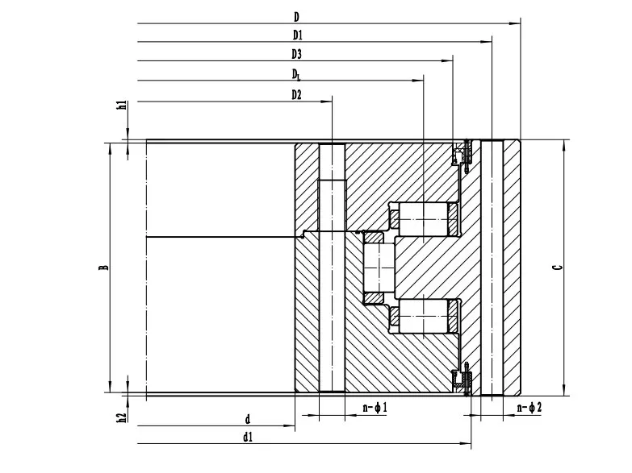
Bearing types & Comparison
Triple-row roller bearing:
[1]
used as slewing bearings
consist of one radial roller row (to take radial load) and two axial roller rows (to handle axial loads in both directions or thrust)
very high capacity in all directions, relatively robust to high loads
Muthu Thirunavukarasu

Slide 11
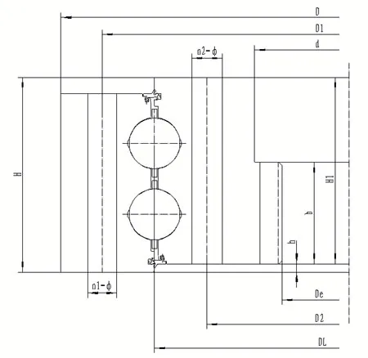
Four-point contact ball bearing
[2]
a single-row angular contact ball bearing that is designed so each ball contacts the inner and outer rings in four points under combined loading.
It is Bidirectional Axial Load Capacity: They can support axial loads in both directions (push and pull), which is very helpful when the bearing must resist tilting moments or reverse loads.
Muthu Thirunavukarasu

Slide 12
Criteria | Triple row roller bearing | Double row 4-Point contact ball bearing
Contact area & Pressure | Line contact and low contact pressure | Point contact and high contact pressure
Contact angle | Axial row 90°and radial 0° | Initial Angle of contact 45°
Load bearing capacity | High due to large contact area | Comparatively low
Deformation | Low bearing ring deformation and ring separation under load | High bearing ring deformation and ring separation under load
Edge loading | Raceways edge loading occurs due to rollers can tilt during ring deformation, but it is low | High Edge loading occurs due to ball moves towards raceway edge under load
Radial load | Very low due to radial row of roller | High, which results in periodic ring stresses
Load carrying by raceways | At a time only one raceway carries the load | At a time both raceways carry the load
Manufacturing Complexity | Very high | Moderate
Moment load capacity | Very high
Wear Service Life | High due to line contact | Less due to point contact
Stiffness | High | Medium - Low
Axial load capacity | Very high | Moderate
Muthu Thirunavukarasu

Slide 13
We have chosen Triple ball bearing as of now because of their superior moment capacity and stiffness. It is also a choice because of its combined-load capacity. We want to discuss further more about the chosen type and produce calculations in the coming week.

Slide 14
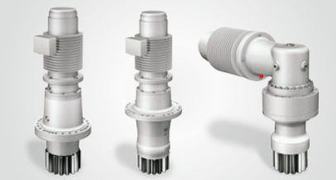
Market research to find a suitable pitch drive
Nidec conversion
Since 1990, SSB Wind Systems has offered technology and know-how for onshore.
Advantages:
Pitch systems Range (750 kW to 15 MW)
Can be used in Hot, cold and normal climate version
Retrofittable
Highly flexible systems
Both battery and self-developed UltraCap backup solutions
Spare parts supply over the entire turbine lifecycle up to 30 years

Slide 15
Liebherr
over 25 years of experience in the wind industry
More than 25,000 wind turbines around the world are equipped with Liebherr components
Ensure continuous availability of components

Slide 16
Bibliography
1. http://xql-slewingbearing.com/3-3-wind-turbine-main-bearings.html
2. http://xql-slewingbearing.com/3-3-wind-turbine-main-bearings.html
3. DNV-RP-C203 / DNV-GL-ST-0376 (Rotor blades and pitch system design standards)
4. Large-diameter bearings for wind turbines” (Technical Paper 6002, 2022)
5. Timken – Wind-Energy Engineering Guide (2020)
6. Axial & Radial Load Capacity SKF (2023)
7. SKF Catalogue(2023)
8. https://share.google/Rk8wjXCYgb9xRfErD
Muthu Thirunavukarasu

